Slide 1


Slide 2
Presented By:
Aswini A. Patil
submission Date:12/05/2022

Slide 3
Customer Retention
WHAT IS THIS AND WHY IS THIS REQUIRED FOR EVERY ORGANIZATION?

Slide 4
What is Customer Retention?
Customer retention is the ability to keep customers coming back to your store or website to create repeat business and investment.
Keep your Customer engaged and Build Trust.
Customer Retention ensure customer loyalty.
It is the process of engaging existing customers to continue buying products or services from your business.
In Other Words Customer Retention means
“to maintain existing customers”

Slide 5
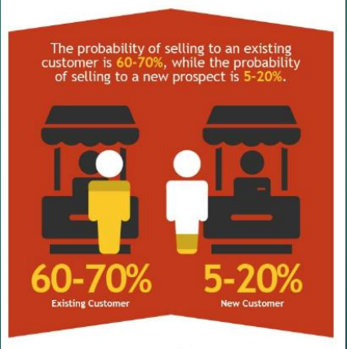
It’s different from customer acquisition or lead generation because you have already converted the customer at least once.
Your probability of selling to an existing customer is at least 40 percent more likely than converting someone who has never bought from you before.

Slide 6

Customer Retention (CR)
Its not a tool its an Art

Slide 7
What are the benefits of CR?
Retained customer tend to buy other services from the same company
Retained customer are known to be less price/cost effective
Positive publicity - Free Marketing 24 x7
The probability of selling to an existing customer is 60 – 70%
While the probability of selling to a new customer is 5-20%
Decline Migration rate

Slide 8
Retention Tactics
Poor customer service brings 70% of customer loss
Always ask for feedback from customer
Listen first, understand and then talk
Bring your customers together
Give priority and importance to customers always
Find out what makes customer to stay or leave
Analyze customer feedback to gain valuable insights and ensure that right person hear it.

Slide 9
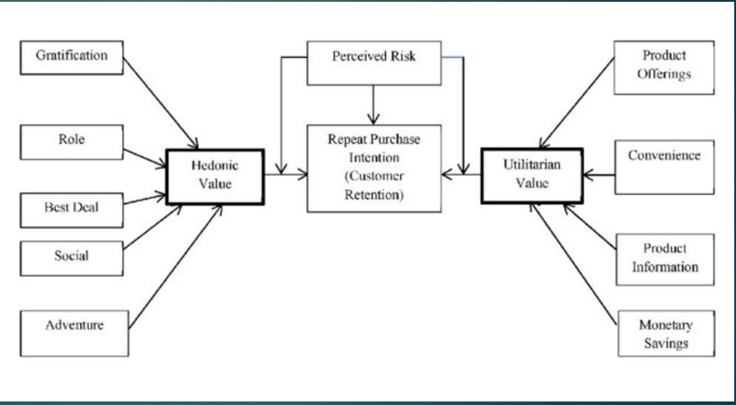
Some Key points to Retain Customers
We will analyze our data In accounts to these key points
Data is about to 5 Companies
1. Amazon
2. Flipkart
3. Myntra
4. Paytm
5. SNapdeal

Slide 10
Hedonic Values
Hedonic shopping value reflects the value received from the multisensory, fantasy and emotive aspects of the shopping experience
Hedonic goods are multisensory and provide for experiential consumption, fun, pleasure, and excitement. It comes with good feeling.

Slide 11
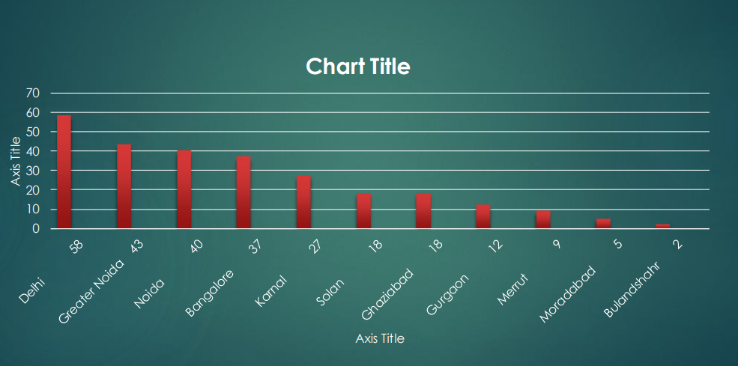
Top 10 Cities for e-commerce

Slide 12
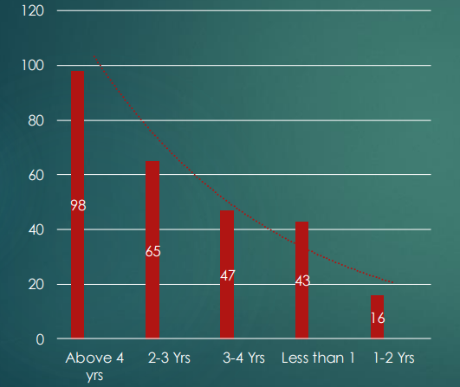
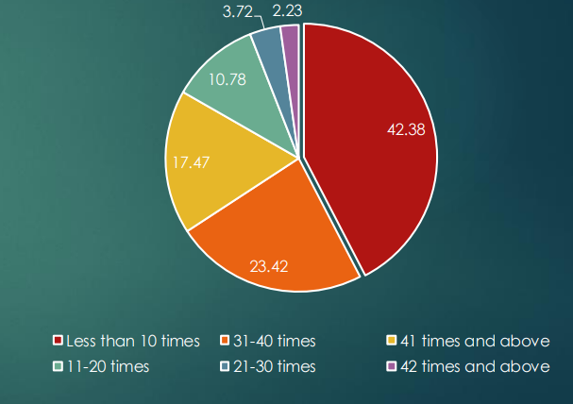
Shopping Pattern
How many times you have made
an online purchase in the past 1 year?
Since how long you are shopping online?

Slide 13
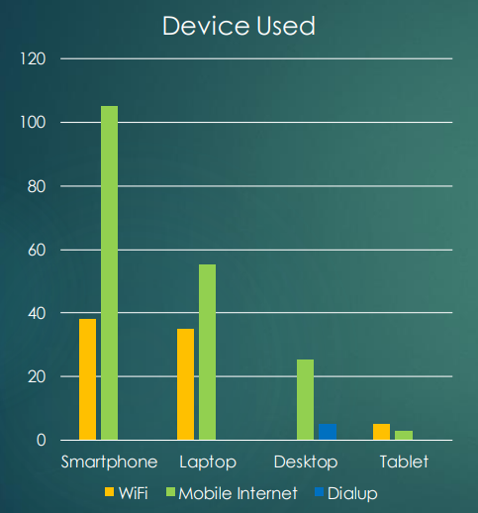
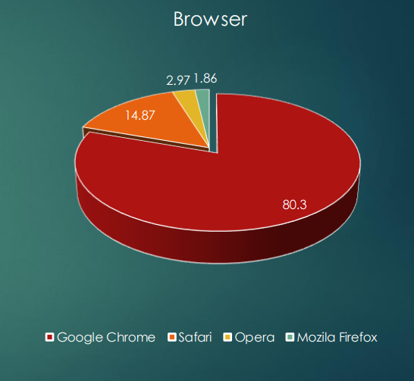
How they do shopping?

Slide 14
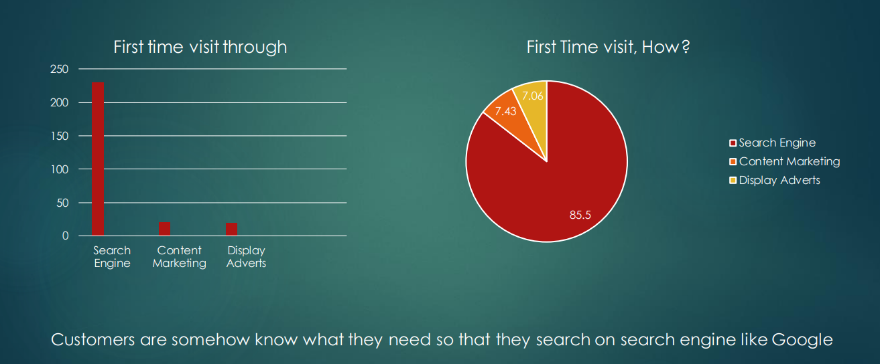
How Customer reached to online website?

Slide 15
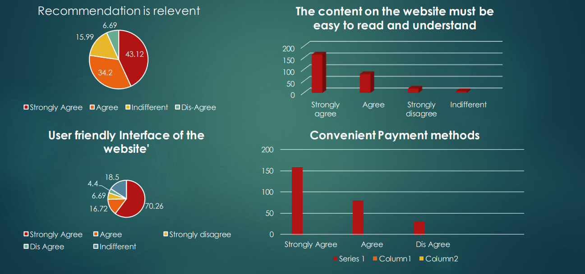
Website content

Slide 16
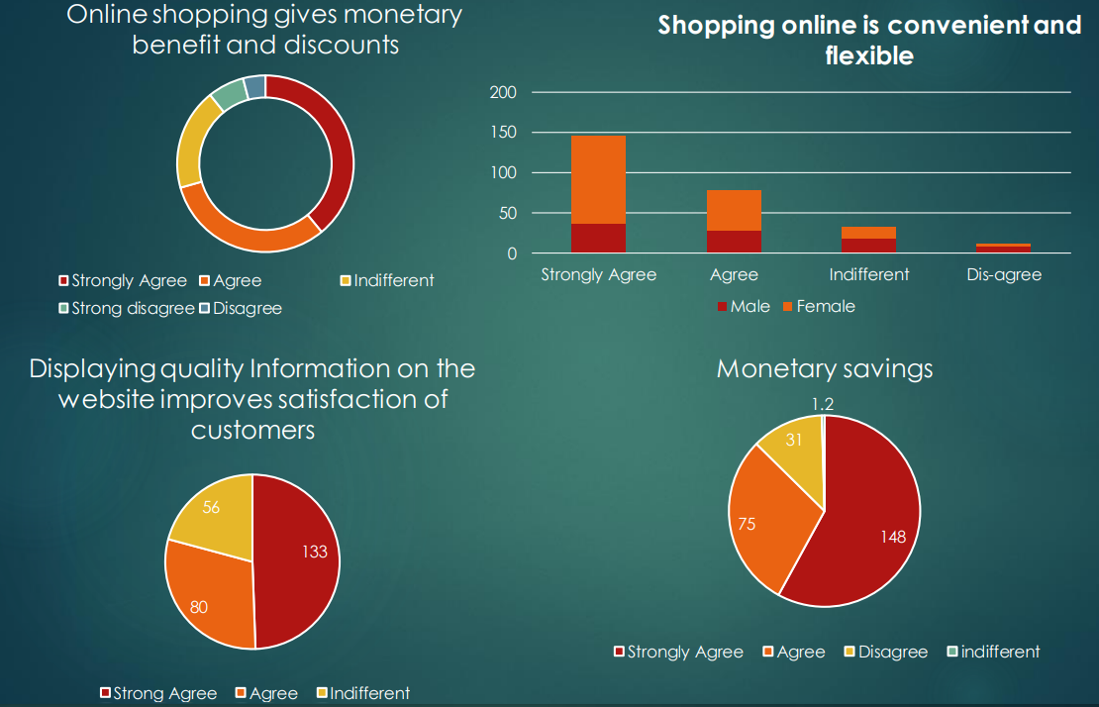

Slide 17
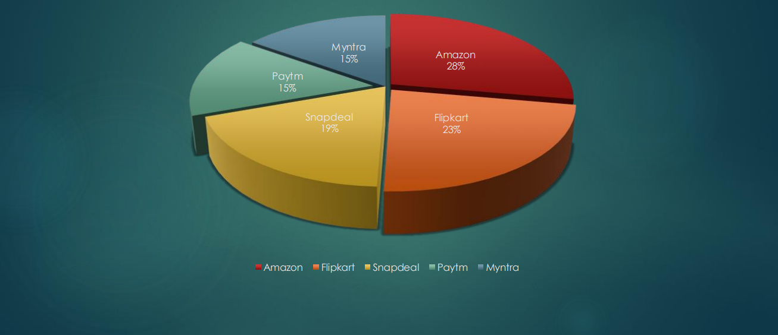
Online retailer preferred:
Company

Slide 18
When should you focus on retention?
Will be dependent on where you’re at in your business journey.
If you’re just staring out you’re gonna focus solely on acquiring new customers, and building up your base.
Once you start getting traction, spend most of your time trying to get new customers in the door. But don’t neglect your current customers.

Slide 19
How to boost customer retention
Improve your customer support
A solid customer support strategy includes attention to the customer pre, mid and post sale.
So an effectively resolved complaint can result in a loyal repeat customer. If you help customers avoid problems and get the most out of your products, you’re going to be helping them, and you’ll be helping your bottom line.
Having a live chat available can turn a customer question into a sale or complaint into a resolution

Slide 20
Offer A Discount Or Credit
Generally, I would tell you to be wary of discounting. You compete with yourself because customer start to expect lower prices from you.
However, when discounts are sent to a first-time buyer, I actually love it. You can also discount to re-engage customers that haven’t purchased in a while.
So if you do have space to do this, try giving your customers 20% off and really think of it as investment in boosting repeat customer rate.

Slide 21
Customer Relationship and Retention Tactics
It’s a universal truth that we have heard time and again. Retaining existing customers is far less expensive than going for new ones.
This is a fact for any business, especially in E-Commerce sector where advertisements, touches and conversions always seem to be enhancing the cost aspects, finding new customers is expensive.
There are some strategies that are commonly implemented by the E-Commerce companies to maintain a strong relation with its customers.

Slide 22
Thank You

